Slide 1
Sentiment Analysis of Lockdown in India During COVID-19: A Case Study on Twitter
MEMBERS: T.Ajay Kumar (202006005)
P.Raja Athiban (202006036)
P.K.Vasanth Ramm (202006253)
GUIDE : Mrs. M.Blessa Binolin Pepsi Assistant Professor(Senior Grade)
Department of Information Technology
Mepco Schlenk Engineering College

Slide 2
Contents
Introduction
Literature Survey
Problem Statement
Objective
Proposed System Design
Module Explanation
Result & Discussion
SWOT Analysis
Conclusion
References

Slide 3
Introduction
Sentiment analysis, also referred to as opinion mining, is an approach to natural language processing (NLP) that identifies the emotional tone behind a body of text.
Sentiment analysis focuses on the polarity of a text (positive, negative, neutral) but it also goes beyond polarity to detect specific feelings and emotions (angry, happy, sad, etc) and even intentions.
Many emotion detection systems use lexicons (i.e. lists of words and the emotions they convey) or complex machine learning algorithms.

Slide 4
Sentiment analysis systems help organizations or government to gather insights from unorganized and unstructured text that comes from online sources such as emails, blog posts, support tickets, web chats, social media channels, forums and comments.
Rule-based systems perform sentiment analysis based on predefined, lexicon-based rules while automatic systems learn from data with machine learning techniques.
There are four types of sentimental analysis they are graded sentimental analysis, emotion detection, aspect-based sentimental analysis, multilingual sentimental analysis

Slide 5
According to the survey, 80% of the world’s data is unstructured. The data needs to be analyzed and be in a structured manner whether it is in the form of emails, texts, documents, articles, and many more.
Sentiment analysis solves real-time issues and can help you solve all the real-time scenarios.

Slide 6
Literature Survey
Sentiment analysis from social media data is one of the highly emerging research fields. It could play a critical role in case of medical emergencies like the COVID-19 pandemic, and hence it is more crucial. Though a lot of research from various angles on sentiment classification and NLP is still in progress, some of the completed works are as follows.

Slide 7
Survey-1
Wu et al. [1] used data from December 31, 2019, to January 28, 2020, on the count of infectious persons exported from Wuhan to deduct the number of cases in Wuhan from December 1, 2019, to January 25, 2020. Cases exported intra-country were then predicted. They predicted that COVID cases across the country by using the flight booking data and COVID-positive persons travelled through flight and thus prognosticated the national and international spread of COVID-19 after calculating the impact of the metropolitan-wide quarantine of Wuhan and surrounding cities which was started in China from Jan 23–24.

Slide 8
Survey-2
Medford et al. [2] fetched tweets related to COVID-19 and calculated the frequency of keywords subject to infection prevention practices, inoculation, and racial partiality. They executed a sentiment analysis to observe sentimental valence and dominant emotions. They performed topic modelling to extract and explore hot discussion topics over time. They extracted 126 049 tweets posted by 53 196 different users. The frequency of COVID-19-related tweets suddenly increased from January 21, 2020 onward. The sentiments are classified from approximately half (49.5%) of all posts expressed fear to about 30% expressing surprise. The number of racial posts closely matched the frequency of new cases of COVID-19 positives. The financial and political effects of COVID-19 were the most common topics in discussion.

Slide 9
Survey-3
Kayes et al. [3] collected 100 000 tweets with the keyword #coronavirus within Australia. Among these 1 lakh tweets, 3076 contain the keyword “social distancing” and #sociald- istancing. They use 8000 tweets for training & validation and 2000 tweets for testing the model. They achieved an accuracy of 83.70% and an F1-Score of 81.62% on the test data. They applied the trained model on the 3076 tweets that contain the keyword “social distancing.” They observed that 80% plus tweets discussed “social distancing” have a positive opinion, as illustrated. They concluded that people in Australia supported social distancing as well as accepted it.

Slide 10
Survey-4
Barkur et al. [10] dealt with Indian citizens’ sentiments after the Indian government announced the lockdown. For analysis, they used the social media platform Twitter. They examined the tweets to extract the sentiments of the Indians regarding lockdown. They extracted the tweets using the two frequently used hashtags: #IndiaLockdown and #Indiafight- sCorona from March 25, 2020 to March 28, 2020. They examined 24000 tweets for the study using software R and generated a word cloud that evaluates the sentiments of the tweets. They found that there were sadness, fear, negativity, and disgust about the lockdown, still the positive sentiments were present prominently in the tweets. They concluded that Indians were determined that they had to reduce the spreading rate of COVID-19 and were devoted to it.

Slide 11
Survey-5
Alhajji et al. [11] analyzed a total of 53 127 tweets from Saudi citizens regarding COVID-19 and found that the numbers of positive tweets are greater than negative tweets for almost all the measures. They found that the most positive sentiments were present in the religious practice-related steps. They concluded that Saudi Twitter users have positive sentiments and support toward the infection control steps in fighting withCOVID-19, and this supportive attitude of Saudi citizens results in the overarching confidence of the Saudi government. According to them, at times of pandemic, religious beliefs may also play an important role in preparing believers. They collected separate tweets on various steps taken by the Saudi government. They extracted 9924 tweets after the announcement of the Grand Mosque closure and found that 76.72% of the tweets were positive. Similarly, they collected tweets for Qatif lockdown, closure of schools and universities, shopping malls, parks, and restaurant closure measures, sports competition suspension hashtags, for the congregational and weekly Friday prayers suspension measure, and finally for nationwide curfew measure.

Slide 12
Problem Statement
To analysis the sentiment of Indian citizens whether the data is positive , negative or neutral ,Which helps the government to reduce the spread of the disease.
To Handle Sentiment Analysis using NLP and Machine Learning Algorithms.

Slide 13
Objective
To mine the sentiments of Indian citizens regarding the nationwide lockdown enforced by the government to minimize the rate of spreading of Coronavirus.
The sentiment analysis of tweets posted by Indian citizens has been performed using NLP and machine learning classifiers.
To classify the data accurately, eight different classifiers are used.
To improve accuracy, a consolidated result of TextBlob and VADER libraries is used.

Slide 14
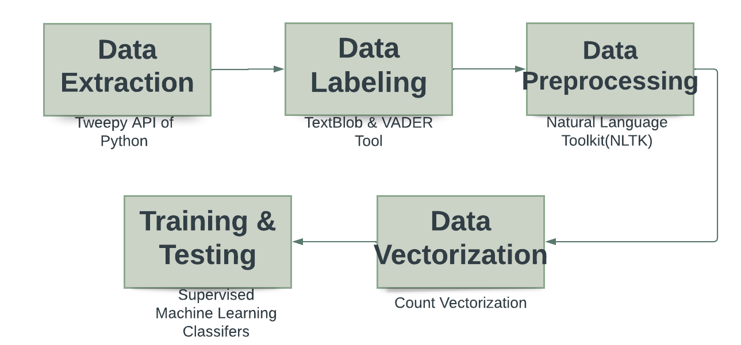
Proposed System Design

Slide 15
Module Explanation
1.Data-Extraction
Data extraction is the process of collecting or retrieving disparate types of data from a variety of sources
Tweepy & Twint are open-sourced, easy-to-use Python libraries for accessing the Twitter API.
It gives you an interface to access the API from your Python application.
In this project, we used both tweepy & twint to extract the tweets from twitter for the keyword “covid19 ”.

Slide 16
2.Data Labeling
Data labeling is the process of identifying raw data and adding one or more meaningful and informative labels to provide context so that a machine learning model can learn from it
TextBlob is a Lexicon-based sentiment analyzer It has some predefined rules, where it has some scores that help to calculate a sentence's polarity. That's why the Lexicon-based sentiment analyzers are also called “Rule-based sentiment analyzers”.
VADER (Valence Aware Dictionary and sentiment Reasoner) is a lexicon and rule-based sentiment analysis tool that is specifically attuned to sentiments expressed in social media.

Slide 17
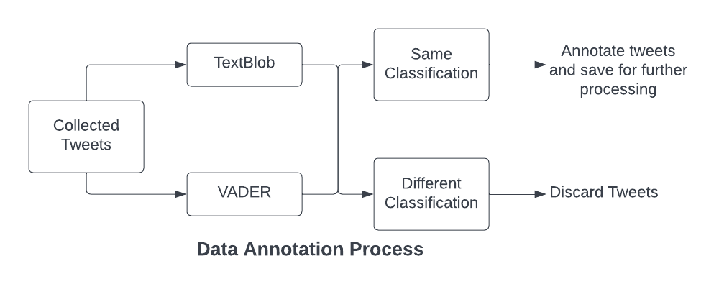
3.Data Labeling Process

Slide 18
4.Data Preprocessing
The data we have collected may hold some unsought and sentiment fewer words like links, Twitter-specific words such as hashtags (starts with #) and tags (starts with @), single letter words, numbers, etc. These types of words can play the role of noise in our classifier training and testing. To amend classifier efficiency, it is necessary to remove noise from the labelled data set before feeding the classifier.
The Operations includes Lowercasing , Removing Extra Spaces , Tokenization , Stop Words Removal , Removing Punctuations , Removal of Frequent Words , Stemming, Lemmatization , Removal of URLs , Removal of HTML Tags

Slide 19
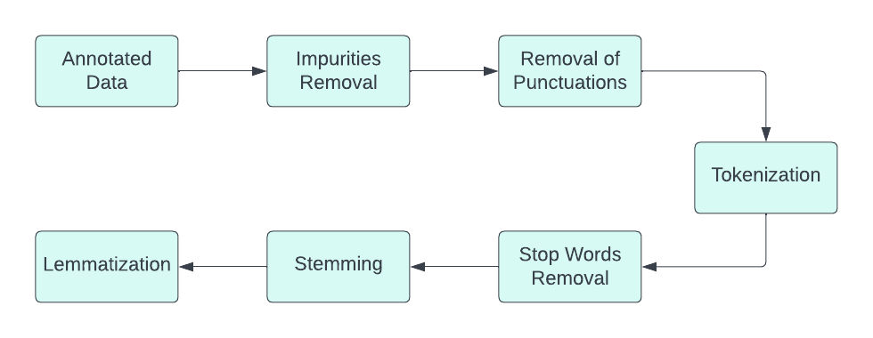
Data Preprocessing Process

Slide 20
5.Data Vectorization
The machine learning classifiers cannot take the input written in any language except numbers. Thus, before using the text data for predictive modelling, it is required to convert it into features. We have used the CountVectorizer feature extraction to calculate word frequencies.
CountVectorizer counts the frequency of each word present in the document and creates a sparse matrix.
For example, Doc1 have “She was young the way an actual young person is young.”

Slide 21
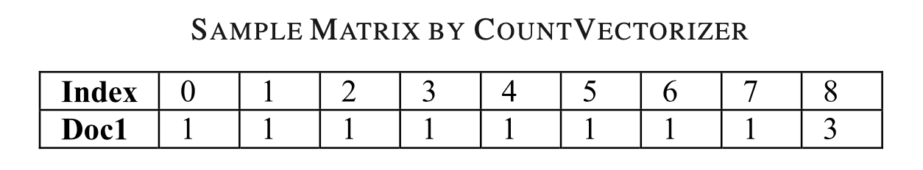
CountVectorizer will convert this text into the following sparse matrix with an index of the words in alphabetical order as follows: {“she”: 4, “was”: 6, “young”: 8, “the”: 5, “way”: 7, “an”: 1, “actual”: 0, “person”: 3, “is”: 2}.

Slide 22
6. Training and Testing the Classifiers
We have used supervised machine learning algorithms for training and testing data.
After feature extraction of the preprocessed data set, we have passed the data to machine learning classifiers. We have used eight classifiers, they are Multinomial Naive- Bayes , Bernoulli Naïve Bayes , Logistic Regression , Linear SVC , Ada Boost Classifier , Ridge Classifier , Passive Aggressive Classifier and Perceptron.
We have used 80% data for training and 20% data for testing the classifiers.

Slide 23
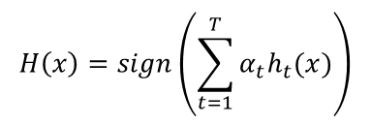
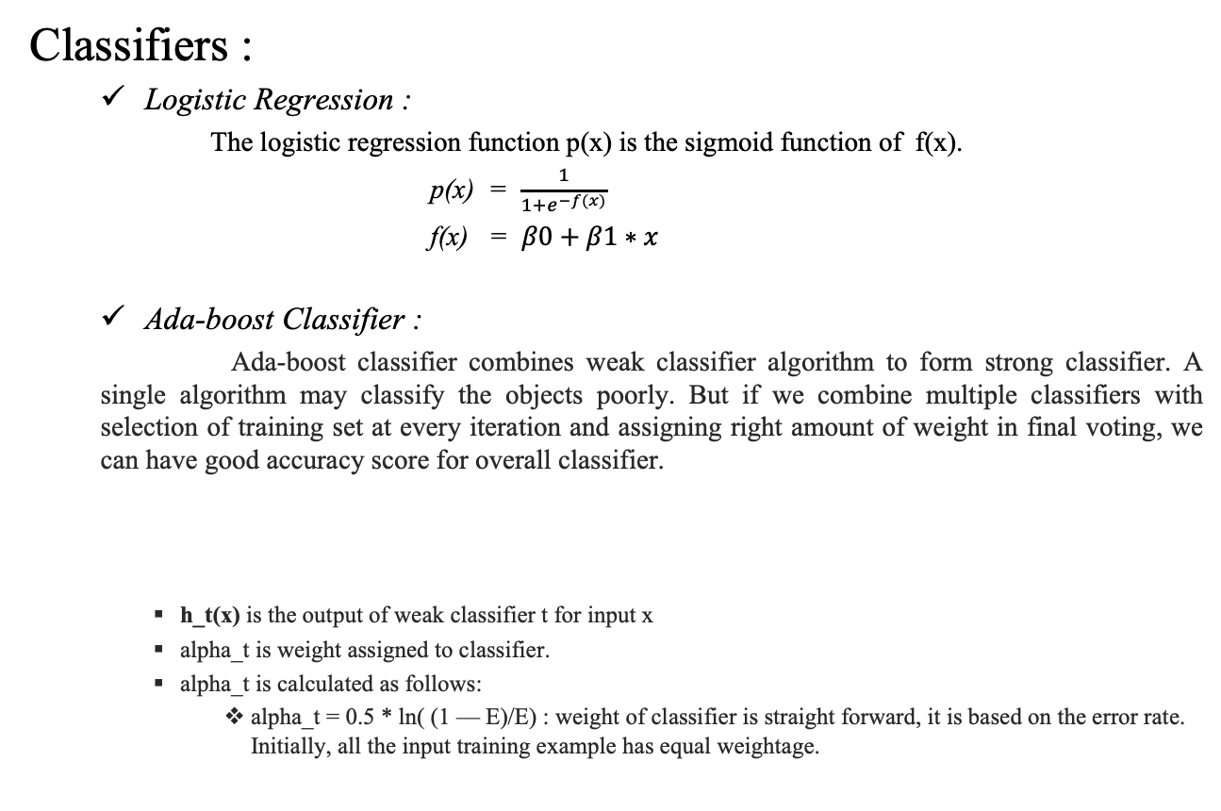
Classifiers :
Logistic Regression :
The logistic regression function p(x) is the sigmoid function of f(x).
p(x) = $\frac{1}{1+e^{−f(x)}}$
f(x) = $β0+β1∗x$
Ada-boost Classifier :
Ada-boost classifier combines weak classifier algorithm to form strong classifier. A single algorithm may classify the objects poorly. But if we combine multiple classifiers with selection of training set at every iteration and assigning right amount of weight in final voting, we can have good accuracy score for overall classifier.
h_t(x) is the output of weak classifier t for input x
alpha_t is weight assigned to classifier.
alpha_t is calculated as follows:
alpha_t = 0.5 * ln( (1 — E)/E) : weight of classifier is straight forward, it is based on the error rate. Initially, all the input training example has equal weightage.

Slide 24
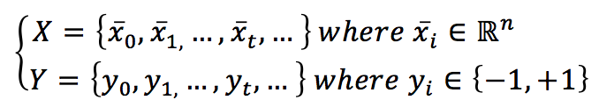
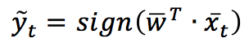
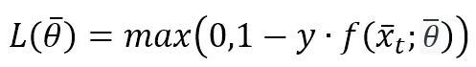
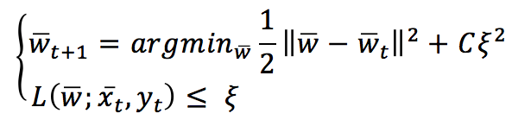
Passive-Aggressive Classifier :
The passive aggressive classifier algorithm falls under the category of online learning algorithms, can handle large datasets, and updates its model based on each new instance it encounters.
Let’s suppose to have a dataset:
Given a weight vector w , the prediction is simply obtained as
All these algorithms are based on the Hinge loss function (the same used by SVM):
The value of L is bounded between 0 (meaning perfect match) and K depending on f(x(t),θ) with K>0 (completely wrong prediction). A Passive-Aggressive algorithm works generically with this update rule:

Slide 25
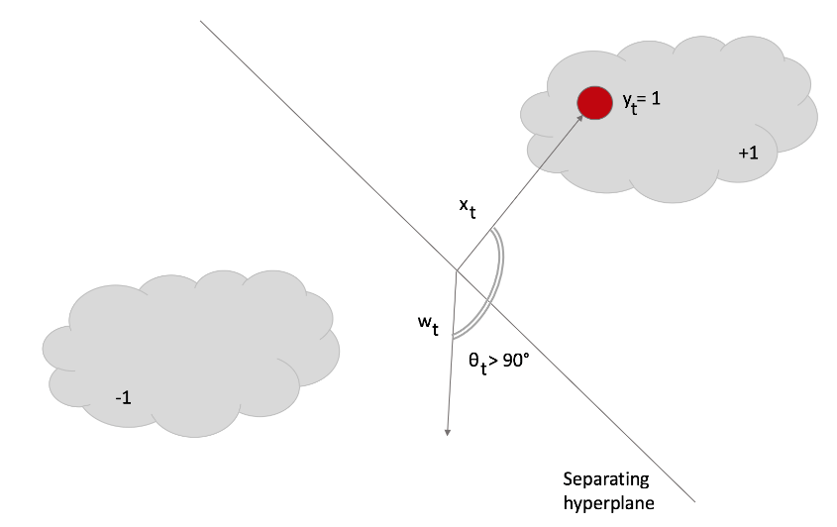
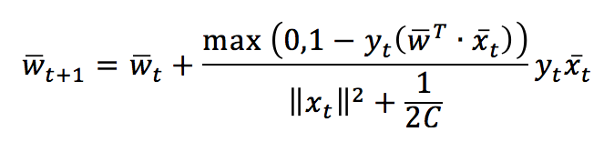
To understand this rule, let’s assume the slack variable ξ=0 (and L constrained to be 0). If a sample x(t) is presented, the classifier uses the current weight vector to determine the sign. If the sign is correct, the loss function is 0 and the argmin is w(t). This means that the algorithm is passive when a correct classification occurs. Let’s now assume that a misclassification occurred:
The closed-form update rule:

Slide 26
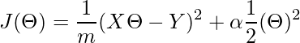
Ridge Classifier :
A Ridge regressor is basically a regularized version of a Linear Regressor. i.e to the original cost function of linear regressor we add a regularized term that forces the learning algorithm to fit the data and helps to keep the weights lower as possible.
The regularized term has the parameter ‘alpha’ which controls the regularization of the model i.e helps in reducing the variance of the estimates.
Cost Function for Ridge Regressor.
Here, The first term is our basic linear regression’s cost function and the second term is our new regularized weights term which uses the L2 norm to fit the data. If the ‘alpha’ is zero the model is the same as linear regression and the larger ‘alpha’ value specifies a stronger regularization.
Perceptron :
Perceptron is a machine learning algorithm which mimics how a neuron in the brain works. It is also called as single layer neural network consisting of a single neuron. The output of this neural network is decided based on the outcome of just one activation function associated with the single neuron

Slide 27
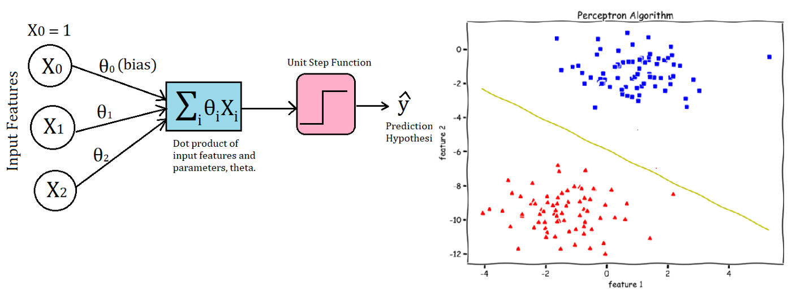
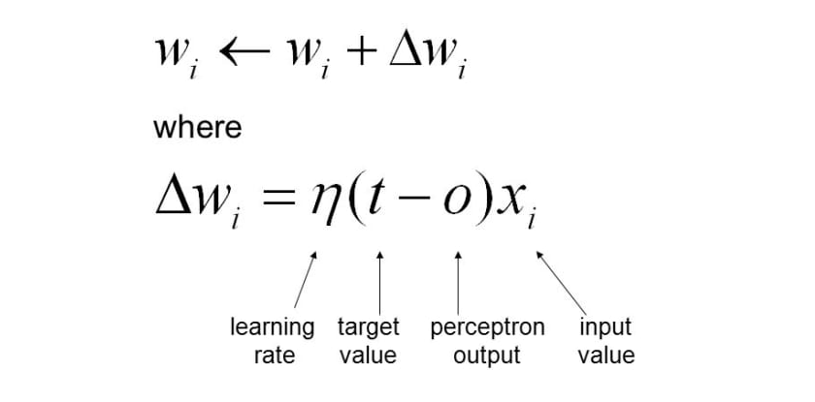

Slide 28
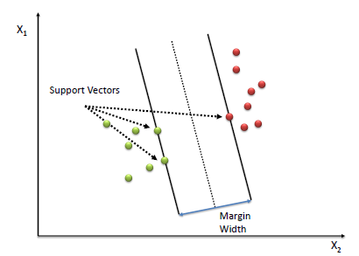
Linear SVC
Linear Support Vector Machine (Linear SVC) is an algorithm that attempts to find a hyperplane to maximize the distance between classified samples.
(X⃗ +−X⃗ −)∙w⃗ ||w|| is the width of the margin. Since Yi(w⃗ ∙X⃗ i+b)=1 is true, X⃗ +w⃗ =1−b, and X⃗ −w⃗ =−1−b, We can rewrite (X⃗ +−X⃗ −)∙w⃗ ||w|| into 2||w||. And our goal is to MAXIMIZE 2||w||.

Slide 29
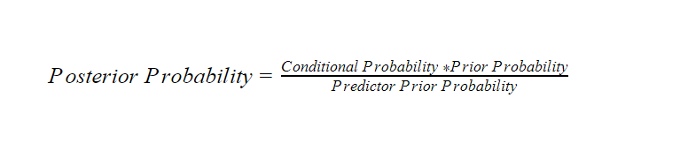
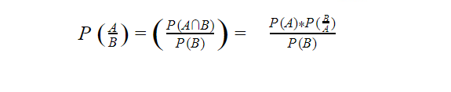
MultinomialNB Classifier :
Naive Bayes Classifier Algorithm is a family of probabilistic algorithms based on applying Bayes’ theorem with the “naive” assumption of conditional independence between every pair of a feature.
Bayes theorem calculates probability P(c|x) where c is the class of the possible outcomes and x is the given instance which has to be classified, representing some certain features.
P(c|x) = P(x|c) * P(c) / P(x)

Slide 30
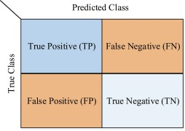
Confusion Matrix :
Confusion matrix is a very popular measure used while solving classification problems. It can be applied to binary classification as well as for multiclass classification problems
Confusion matrix for binary classification

Slide 31
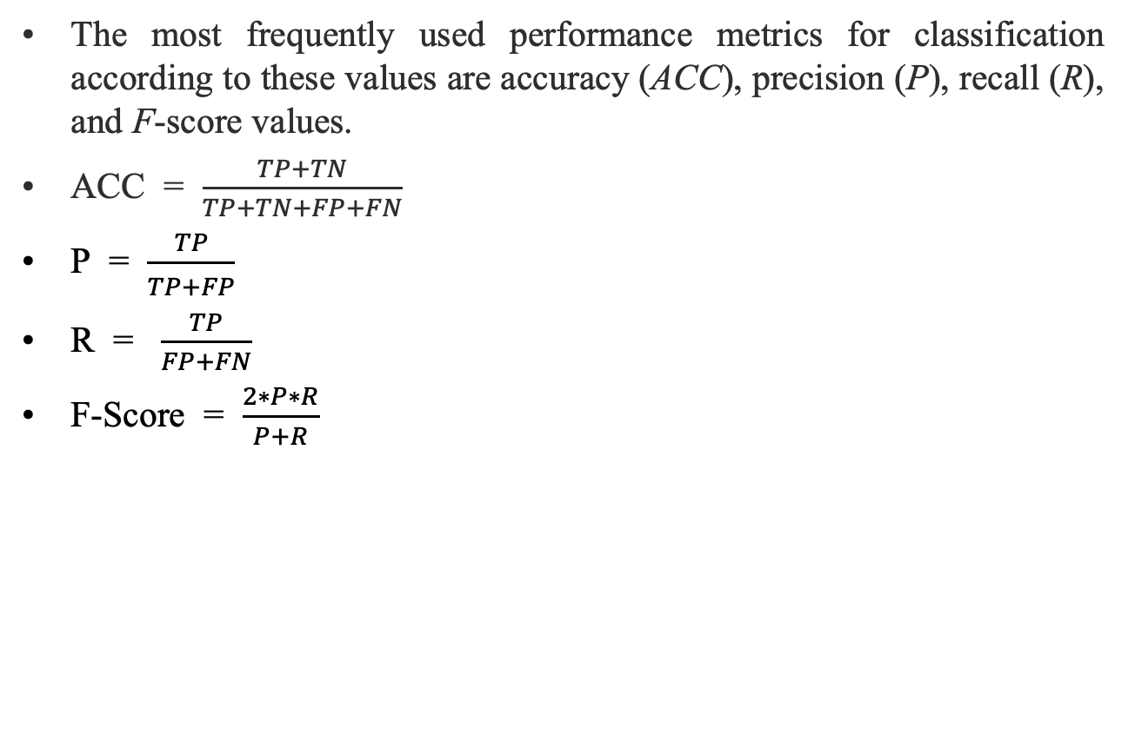
The most frequently used performance metrics for classification according to these values are accuracy (ACC), precision (P), recall (R), and F-score values.
ACC = $\frac{TP+TN}{TP+TN+FP+FN}$
P = $\frac{TP}{\begin{aligned} \\ TP+FP\end{aligned}}$
R = $\frac{TP}{FP+FN}$
F-Score = $\frac{2∗P∗R}{P+R}$

Slide 32
Result & Discussion

Slide 33
Dataset:
We have scrapped the tweets using Tweepy API.
The Tweepy API will sent the request to twitter and after a seconds the twitter will send tweets associated details as a immediate response.
Tweepy API can be obtained using Twitter developer Account.
We just scrapped 13000 tweets using Tweepy API

Slide 34
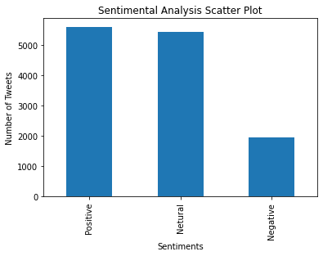
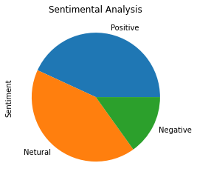
Output

Slide 35
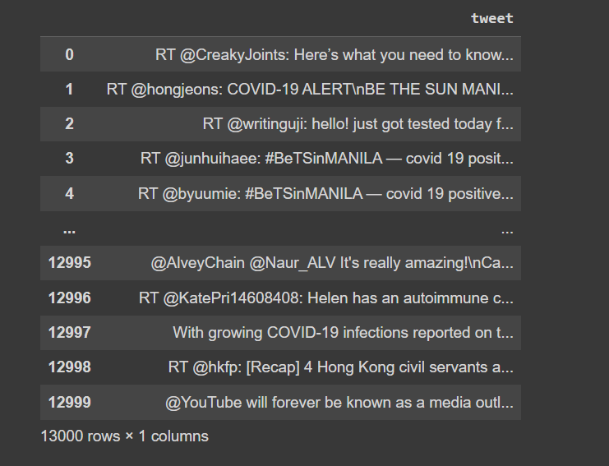
Contd...
Data Extraction using tweepy

Slide 36
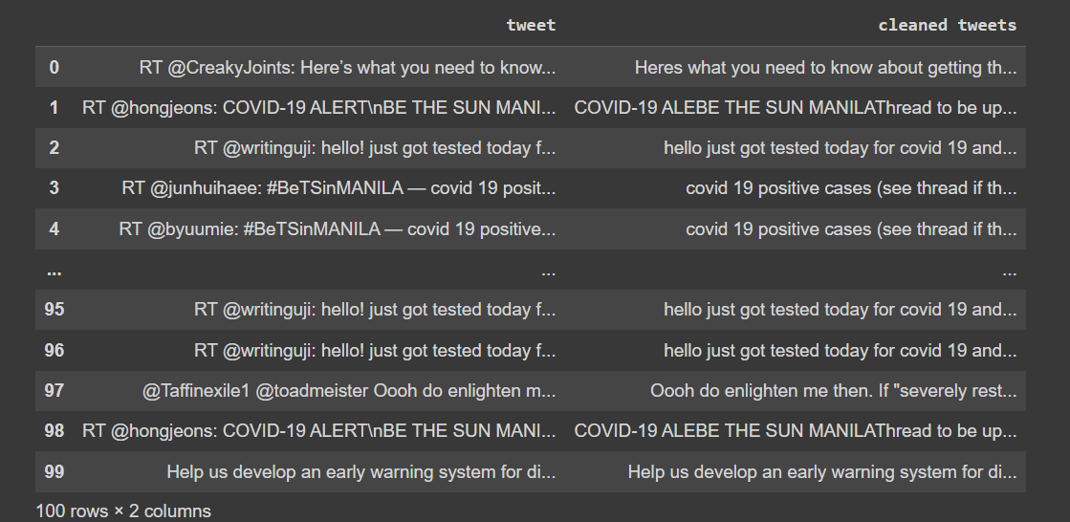
Contd...

Slide 37
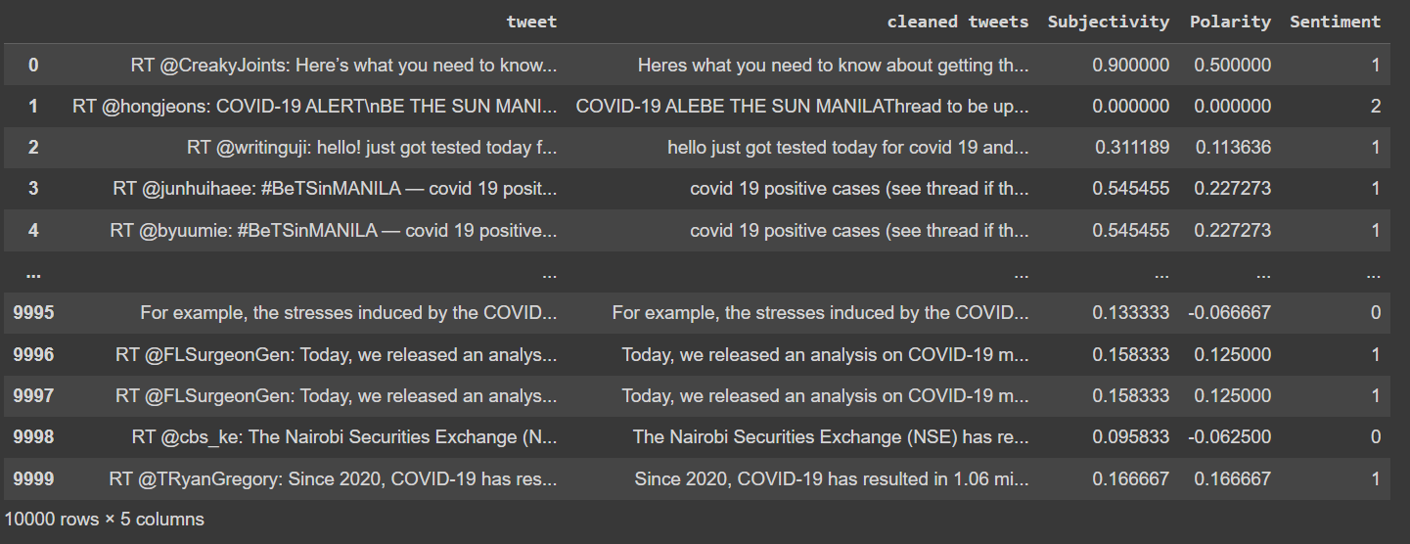
Contd...

Slide 38
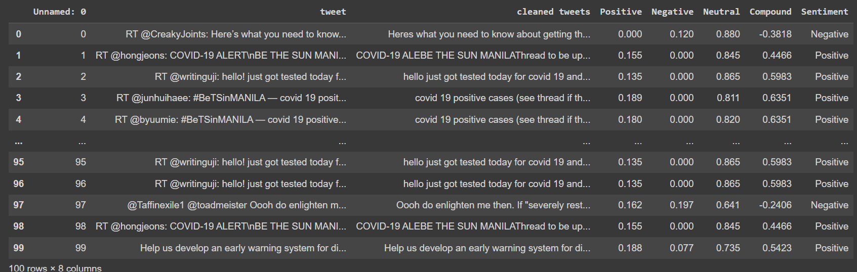
Contd...

Slide 39
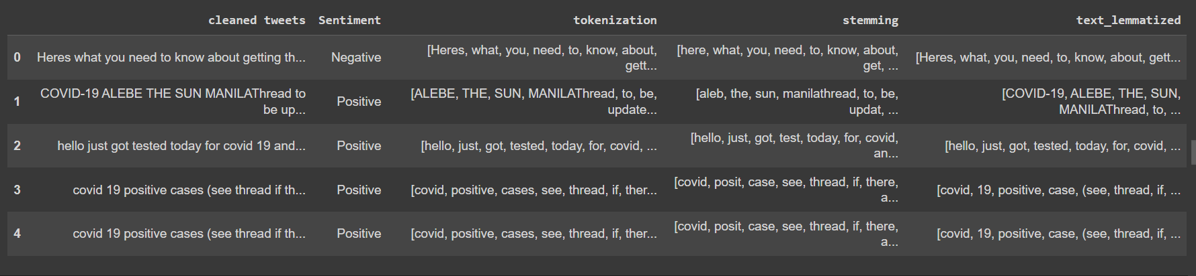
Contd...

Slide 40
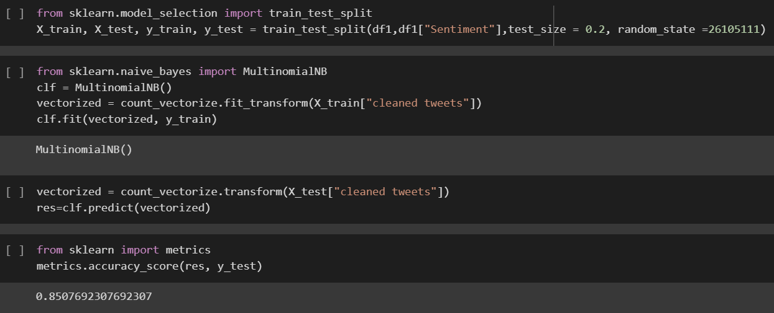

Slide 41
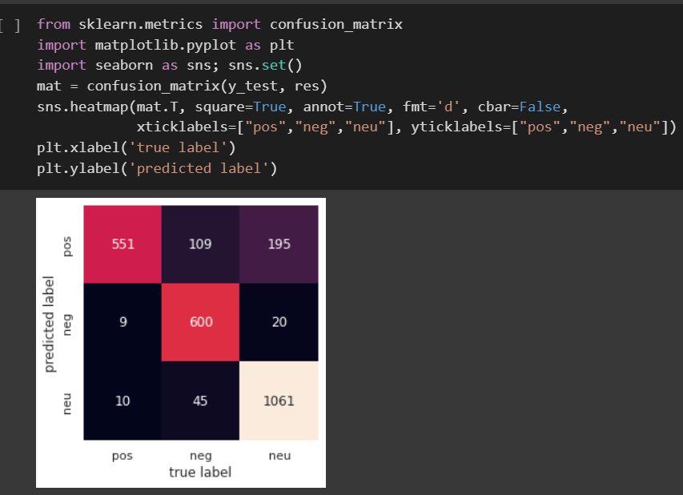

Slide 42
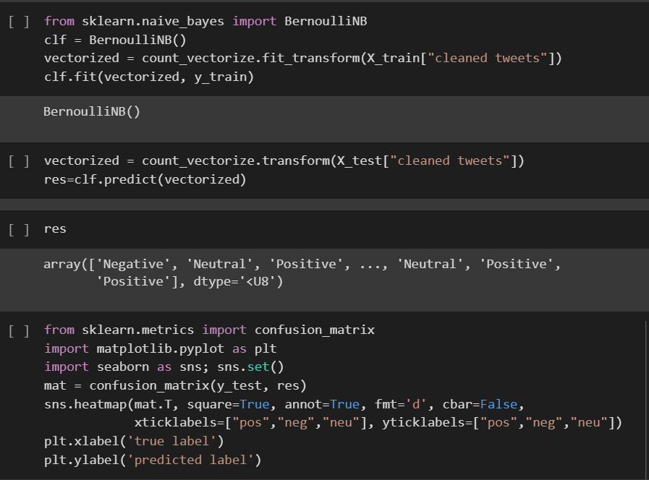

Slide 43
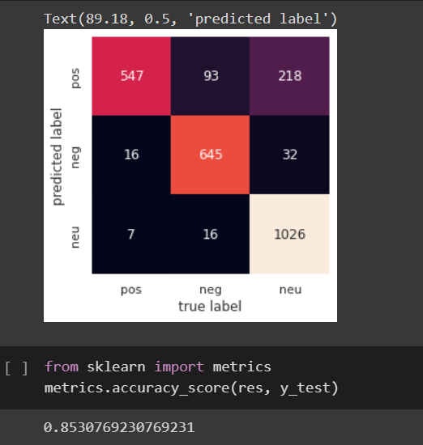

Slide 44
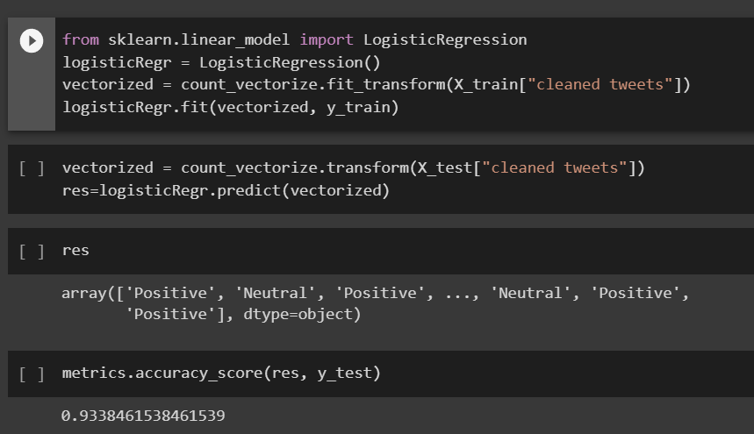

Slide 45
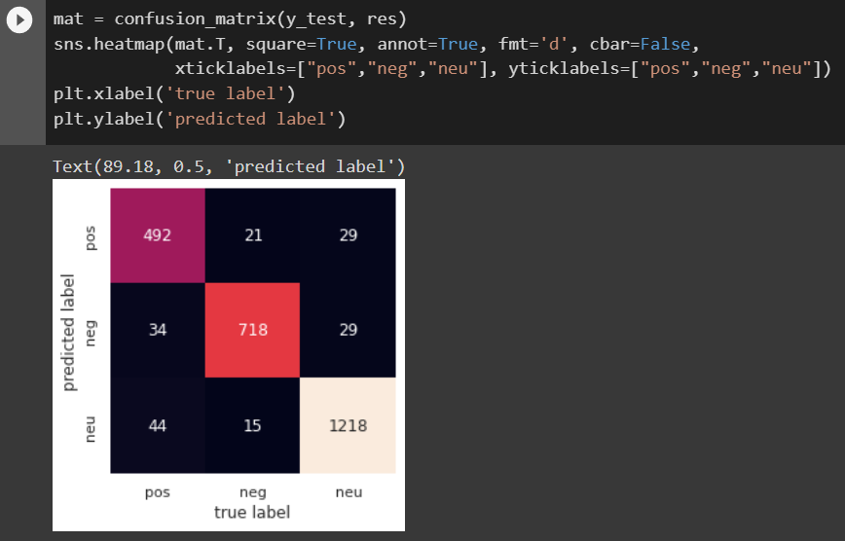

Slide 46
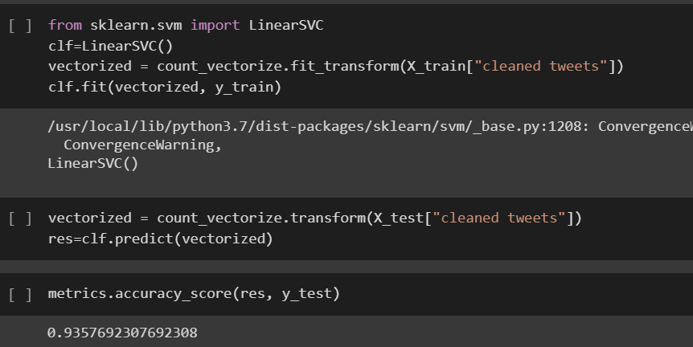

Slide 47
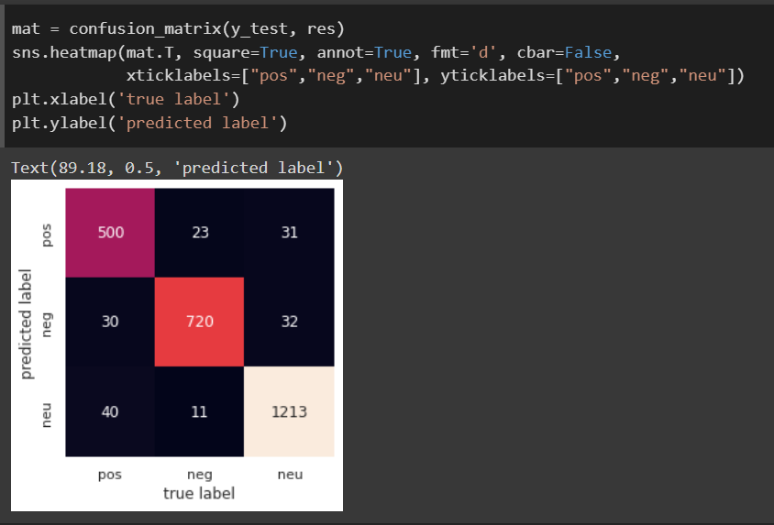

Slide 48
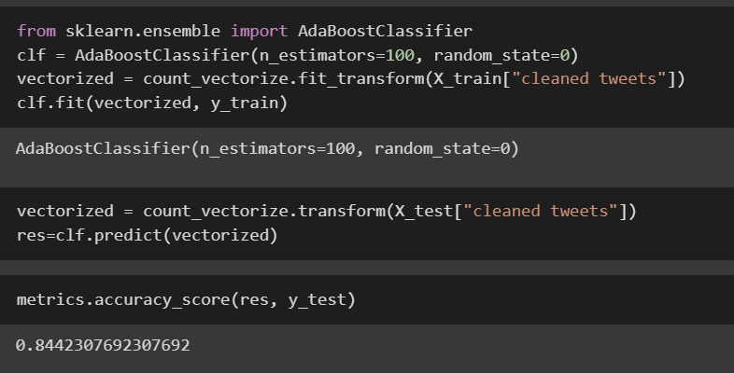

Slide 49
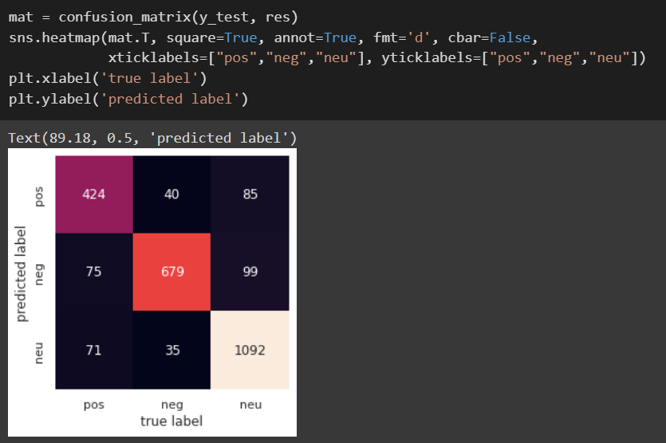

Slide 50
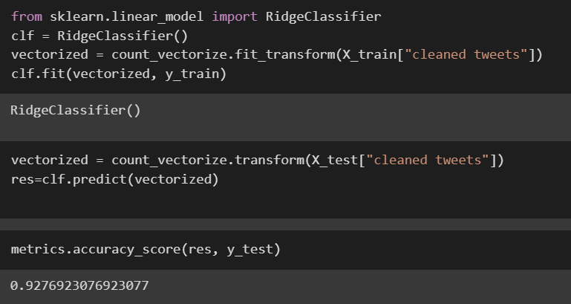

Slide 51
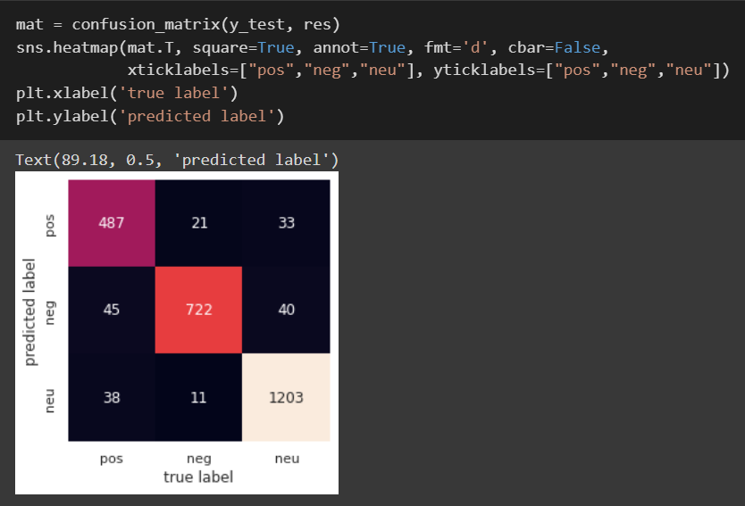

Slide 52
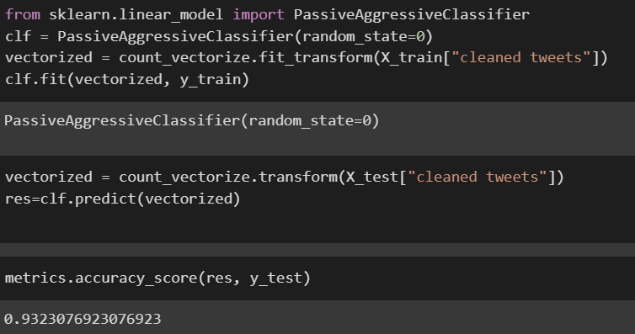

Slide 53


Slide 54
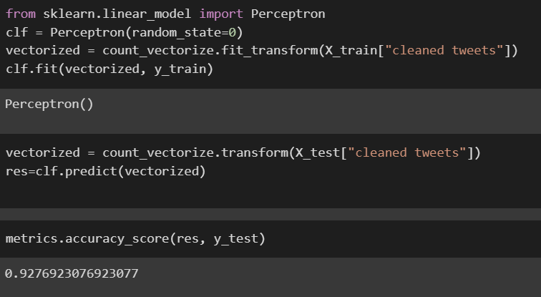

Slide 55


Slide 56
Result

Slide 57
Code

Slide 58
SWOT Analysis
Strength
allows you to keep track of what's being said about your product or service on social media.
can help you detect angry customers or negative mentions before they they escalate.
Weakness
Due to the presence of non-useful characters (collectively termed as the noise) along with useful data, it becomes difficult to implement models on them

Slide 59
Contd...
Opportunities
News Trending Analysis
Movie Review Analysis
Customer Feedback
Threat
less accurate when applied to data from other domains such as news or social media

Slide 60
Conclusion
Sentiment analysis of natural languages itself contained a vast scope to work on, and due to health emergencies, this work is also manifested with a wide range of future scopes
Using the posts from Twitter, we examined the common public’s aggregate reaction toward the implementation of lockdown by the Indian government during the spread of COVID-19.

Slide 61
References
[1] J. T. Wu, K. Leung, and G. M. Leung, “Nowcasting and forecasting the potential domestic and international spread of the 2019-nCoV outbreak originating in Wuhan, China: A modeling study,” Obstetrical Gynecolo. Surv., vol. 75, no. 7, pp. 399–400, Jul. 2020.
[2] R. J. Medford, S. N. Saleh, A. Sumarsono, T. M. Perl, and C. U. Lehmann, “An ‘infodemic’: Leveraging high-volume Twitter data to understand public sentiment for the COVID-19 outbreak,” medRxiv, Jan. 2020, doi: 10.1101/2020.04.03.20052936.
[3] A. S. M. Kayes, M. S. Islam, P. A. Watters, A. Ng, and H. Kayesh, “Automated measurement of attitudes towards social distancing using social media: A COVID-19 case study,” Tech. Rep., Oct. 2020.
[4] G. Barkur, Vibha, and G. B. Kamath, “Sentiment analysis of nationwide lockdown due to COVID 19 outbreak: Evidence from India,” Asian J. Psychiatry, vol. 51, Jun. 2020, Art. no. 102089.
[5] M. Alhajji, K. A. Al, M. Aljubran, and M. Alkhalifah, “Sentiment analysis of tweets in Saudi Arabia regarding governmental preventive measures to contain COVID-19,” Dept. Social Behav. Sci., College Public Health, Temple Univ., Philadelphia, PA, USA, Tech.

Slide 62
[6] WHO Statement Regarding Cluster of Pneumonia Cases, WHO, Wuhan, China, 2020.
[7] R. Pandey et al., “A machine learning application for raising WASH awareness in the times of COVID-19 pandemic,” 2020, arXiv:2003.07074. [Online]. Available: http://arxiv.org/abs/2003.07074
[8] C. K. Pastor, “Sentiment analysis on synchronous online delivery of instruction due to extreme community quarantine in the Philippines caused by Covid-19 pandemic,” Asian J. Multidisciplinary Stud., vol. 3, no. 1, pp. 1–6, Mar. 2020.
[9] https://www.analyticsvidhya.com/blog/2021/01/sentiment-analysis-vader-or-textblob/
[10] https://www.analyticsvidhya.com/blog/2021/06/text-preprocessing-in-nlp-with-python-codes/
[11] https://monkeylearn.com/sentiment-analysis/
[12] https://scikit-learn.org/stable/model_selection.html
[13] https://albertauyeung.github.io/2018/06/03/generating-ngrams.html/

